Slide 1
INVOICE PAYMENT INQUIRY IN GSM
GSM function required: AP Inquiry and reporting

Slide 2
How to check the status of an invoice (payment) in GSM
If an invoice has not been paid (or approved for payment), a newly procured fixed asset will not be posted to the GSM Fixed Assets Module (FAM)
This is a common reason why new equipment may not be visible in the FAM even though it has been received and accepted in GSM.

Slide 3
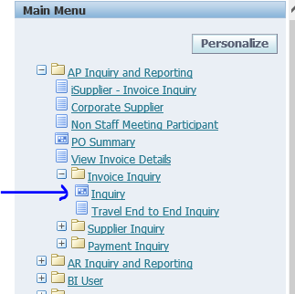
Select 1. GSM function AP Inquiry and Reporting,
then 2. Invoice Inquiry
then 3. Inquiry

Slide 4
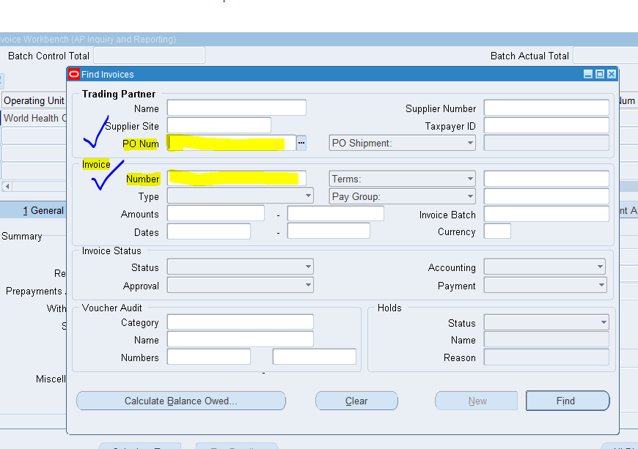
Enter either the PO Number of the asset or, enter the Invoice Number
Click Find

Slide 5
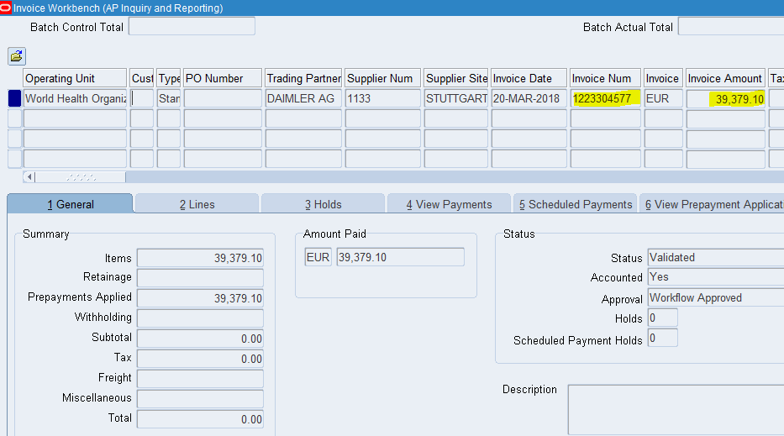
Select:
Holds or View Payments to see the status of the payment.

